Slide 1
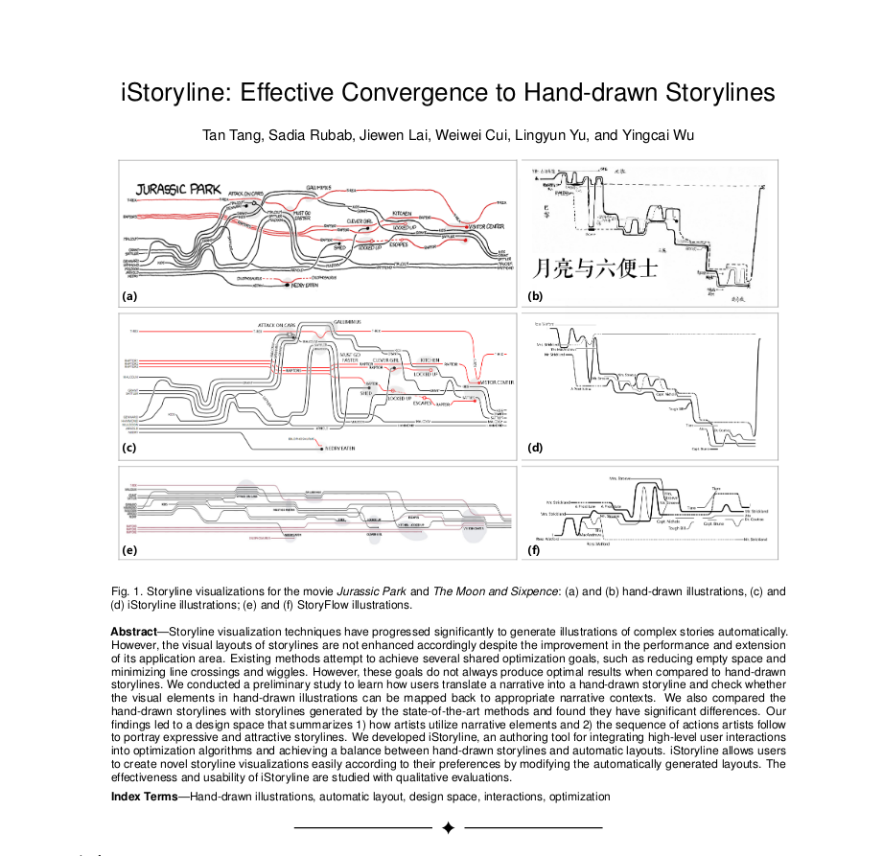

Slide 2

Randall Munroe
degree in Physics
worked at NASA
4942 Munroe
blag
what-if?
xkcd

Slide 3
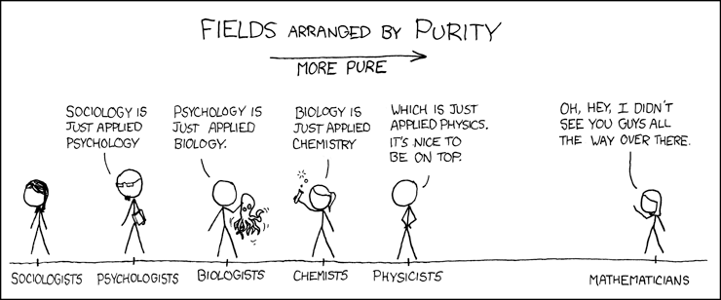
xkcd
I wanted to pick a name that I wouldn’t get tired of. That would just always mean me. So I just went down combination of letters that weren’t taken, until I could find one that didn’t have any meaning, didn’t have any pronunciation, and didn’t seem like an obvious acronym for anything.

Slide 4




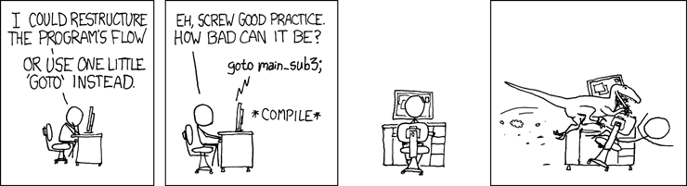
characters

Slide 5
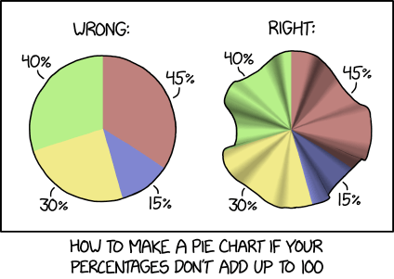
Visualization

Slide 6
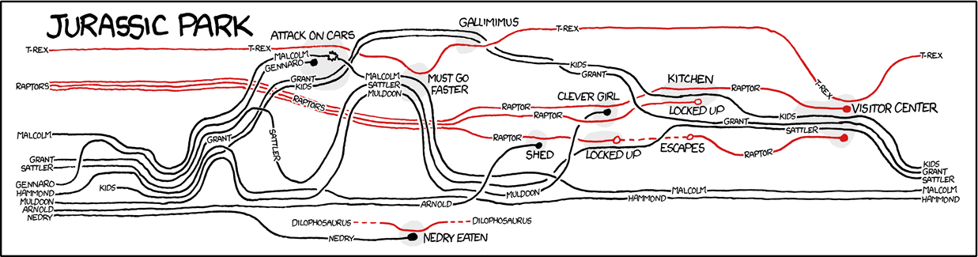
Storyline Visualization

Slide 7
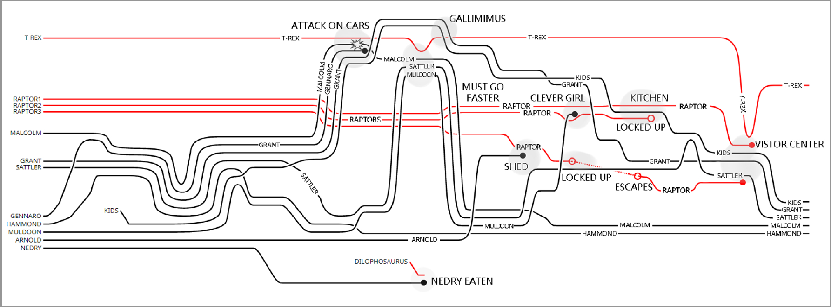
iStoryline

Slide 8
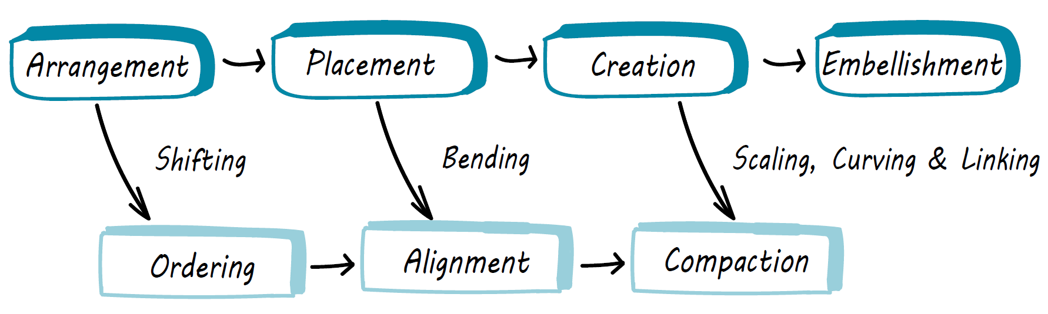
Workflow

Slide 9
References
Artykuł: iStoryline: Effective Convergence to Hand-drawn Storylines
xkcd: xkcd.com

